Slide 1

Quantitative Research in Political Science How to Apply the Classical Toolbox
Giuseppe Carteny
Postdoctoral Researcher
Department of European Social Research
University of Saarland
UdS SoSe2025 - Class 2 (2025.04.14)

Slide 2
Today‘s seminar
Review #1 (quick)
R and programming notions
Review #2 (quick)
Univariate statistics
Hands-on practice
Assignment

Slide 3
Review #1

Slide 4
Assignment #1
Did you practice?
How it was?
Practice
A platform to practice without installation: https://adp-cvk.quarto.pub/r-for-social-science-data-analysis/
Some basic statistics with R: https://statsandr.com/blog/descriptive-statistics-in-r/

Slide 5
Assignment #2
Did you read?
Resources
See the references!
Bueno de Mesquita & Fowlers (2021) - Chapters 2, 3, and 5
King (1998) – Chapter 1
(I’ll share them via Teams later today)

Slide 6
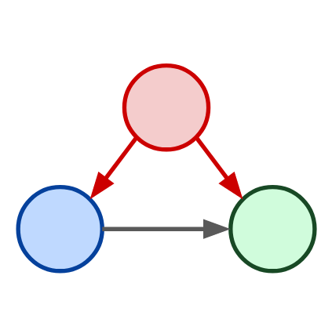
Assignment #3
How is it going with your model?
Confounder
Independent Variable
Dependent Variable

Slide 7
R and programming notions

Slide 8
Checkpoint
Installation
Are R and Rstudio installed on your computer/laptop?

Slide 9
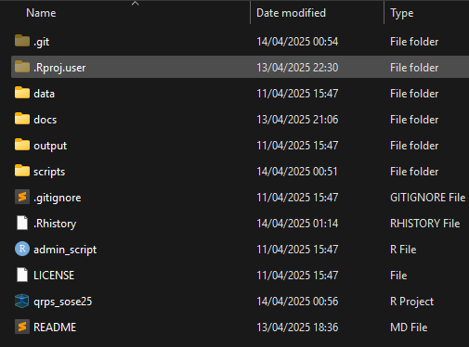
Basic management
A few rules that can make your life easier:
Create an R project
Create a simple, rational folder structure
Keep different file types in different folder
Create sub-folders
Keep it tidy
In naming there are no wrong answers,…
but use all lower case or upper case ( helps you in never forgetting the cases )
but use underscore in between
but make the name as general as possible
! You can create it with R!
Notes:
Separation of concern so that different individual can take care of different parts of a project without worrying about other parts of the project.

Slide 10
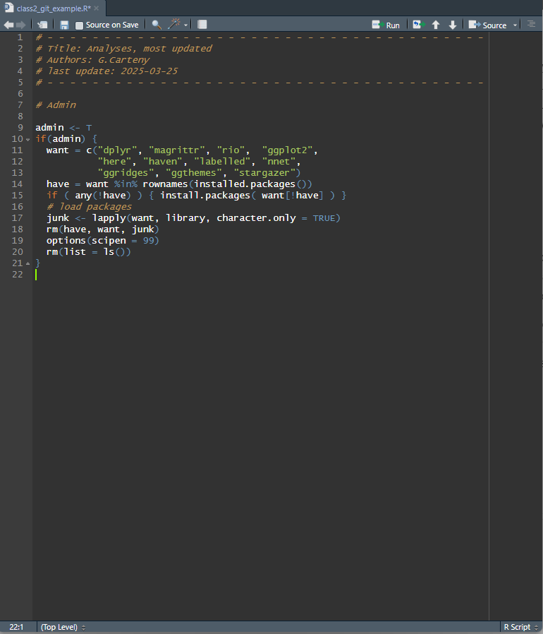
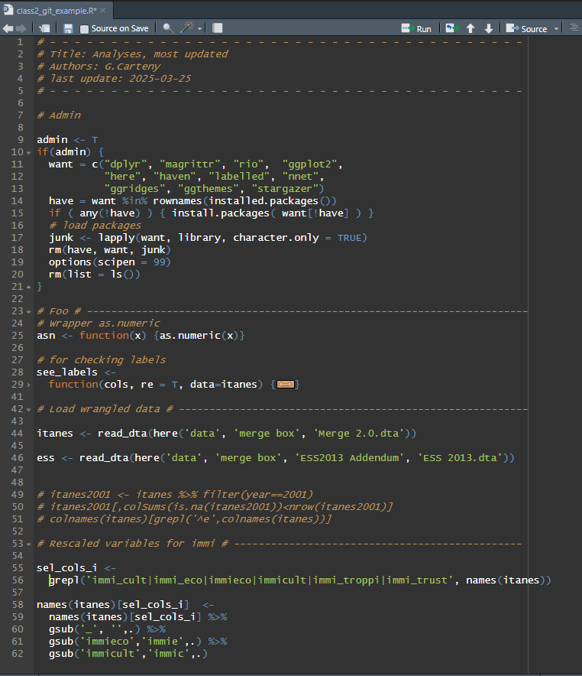
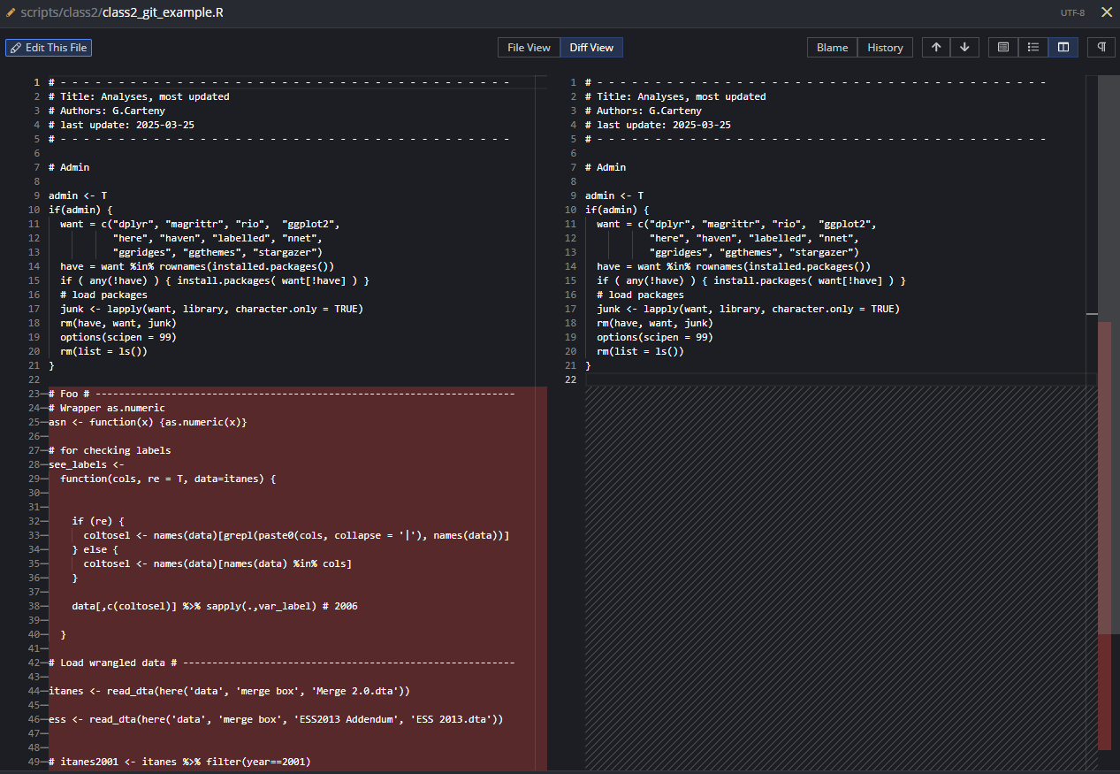

Basic management
Notes:
Separation of concern so that different individual can take care of different parts of a project without worrying about other parts of the project.

Slide 11





Basic management
There is an additional software that can make your life easier
Git: version control system that tracks versions of files
Pros
Very useful backup of your code
Cons
You cannot backup files >~ 20mb
The basic version needs to be programmed using the OS console – e.g., cmd in Windows
But there’s GitHub
A (proprietary) developer platform that allows users to create, store, manage, and share their code.
painful
Notes:
Separation of concern so that different individual can take care of different parts of a project without worrying about other parts of the project.

Slide 12
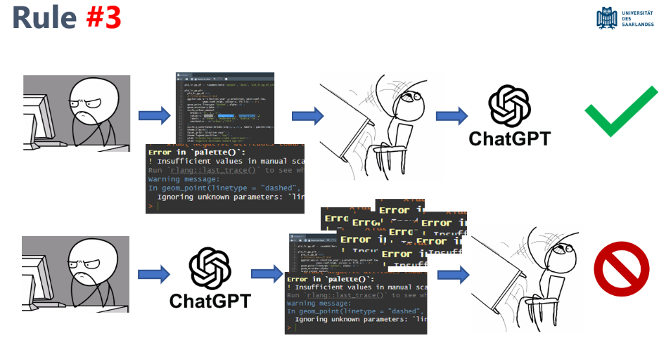
Basic coding
If you want an understandable, efficient code…
DIY: Do it by yourself
Notes:
Separation of concern so that different individual can take care of different parts of a project without worrying about other parts of the project.

Slide 13
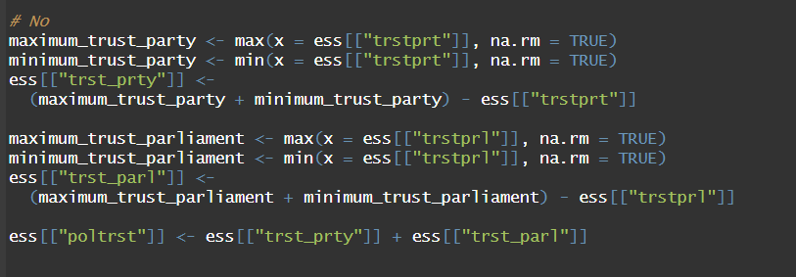
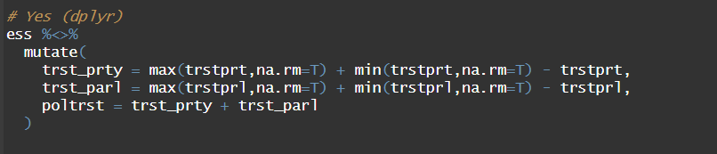
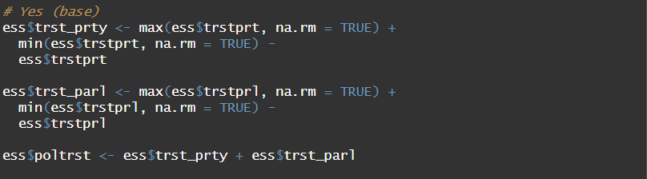
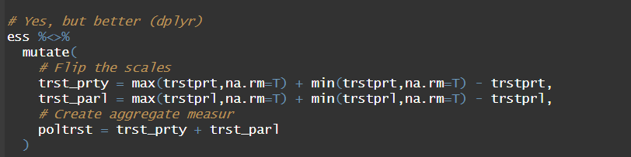
Basic coding
If you want an understandable, efficient code…
DIY: Do it by yourself
KIS: Keep it simple
Be clear about inputs and ouputs
Break down problems, split tasks
Aggregate tasks in the output
Notes:
Separation of concern so that different individual can take care of different parts of a project without worrying about other parts of the project.

Slide 14

Basic coding
If you want an understandable, efficient code…
DIY: Do it by yourself
KIS: Keep it simple
Be clear about inputs and ouputs
Break down problems, split tasks
Aggregate tasks in the output
DRY: Don’t repeat yourself
Do not perform the same calculation/operation twice
Instead define an object/a function
Write comments
Use Rstudio tabs
Debugging will become much much easier…
Notes:
Separation of concern so that different individual can take care of different parts of a project without worrying about other parts of the project.

Slide 15
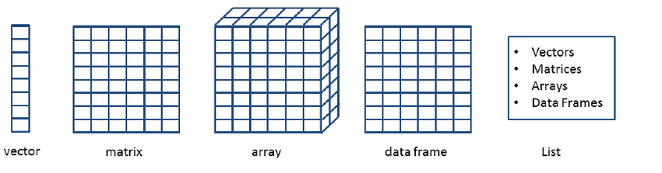
Basic coding
Do you know…
x <– 3
Why R is called an object oriented language?
What’s a numeric/ integer/character object ?
What’s x?
What’s “<-” ?
What’s “3”?
What’s a…
vector?
matrix?
array?
data frame?
list?
Notes:
Vector: A vector is a one-dimensional collection of elements of the same type (e.g., all numeric or all character).
Matrix: A matrix is a two-dimensional array where all elements must be of the same type.
Array: An array is a multi-dimensional generalisation of a matrix, also requiring all elements to be of the same type.
Data frame: A data frame is a two-dimensional table where each column can contain elements of a different type (like a spreadsheet).
List: A list is a flexible container that can hold elements of different types and structures, including other lists.

Slide 16
Review #2

Slide 17
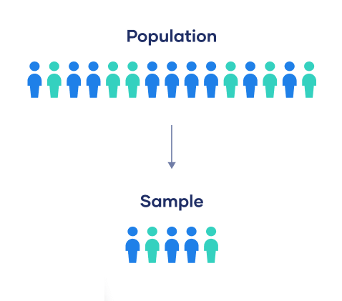
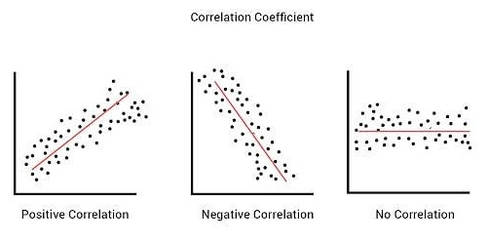
Basic management
The population is the social system about which you want to make some inferences
A sample is… a subset of the population – and it is the only thing we actually observe. Fundamental also because it helps understanding why we need to deal with uncertainty
Observation a basic unit of analysis and/or measurement
Variable feature of the observation that varies
Correlation is the extent to which two features/variables occur together
*
Notes:
Separation of concern so that different individual can take care of different parts of a project without worrying about other parts of the project.

Slide 18
Univariate statistics

Slide 19
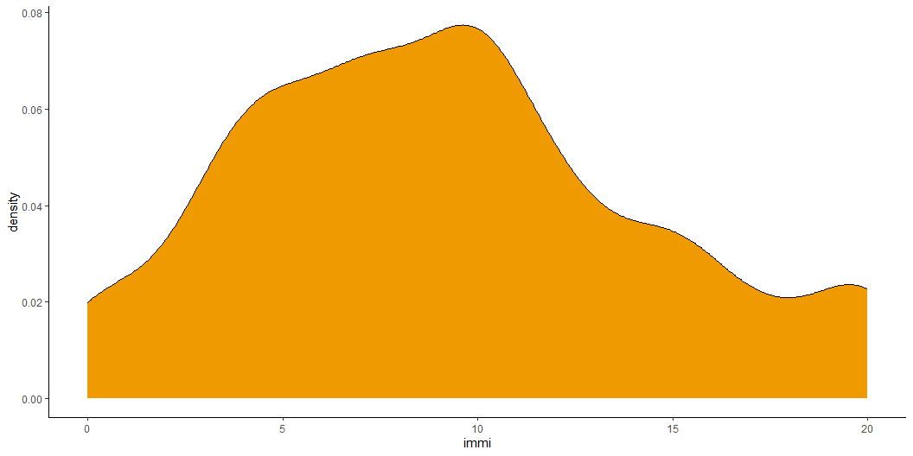
How would you describe this?
Only There are no wrong answers!
Notes:
Separation of concern so that different individual can take care of different parts of a project without worrying about other parts of the project.

Slide 20
Different statistics
Central distribution statistics
Mean
Median
Mode
Correlation statistics
Covariance
Correlation
ChiSq
Dispersion statistics
Variance/Standard deviation
Standard error
Quantiles
Notes:
Separation of concern so that different individual can take care of different parts of a project without worrying about other parts of the project.

Slide 21
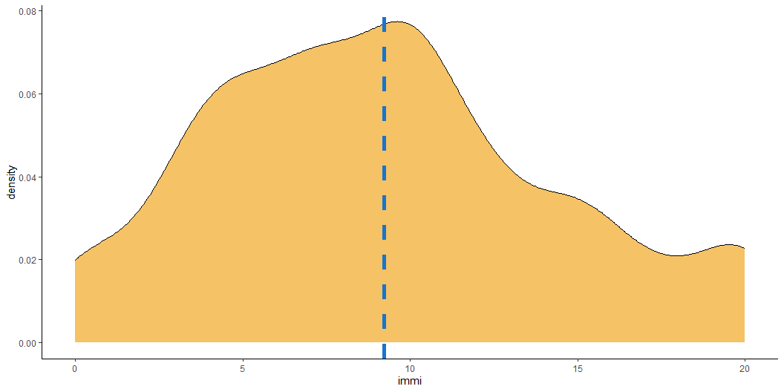
Central distribution Mean
ess_reg %>% mutate( immi_mean = mean(immi, na.rm=T) ) %>% ggplot(aes(x=immi)) + geom_density(fill='orange2', alpha=.6) + geom_vline(aes(xintercept = immi_mean), linetype = 'dashed', colour = 'dodgerblue3', linewidth = 2) + theme_classic()
Notes:
Separation of concern so that different individual can take care of different parts of a project without worrying about other parts of the project.

Slide 22
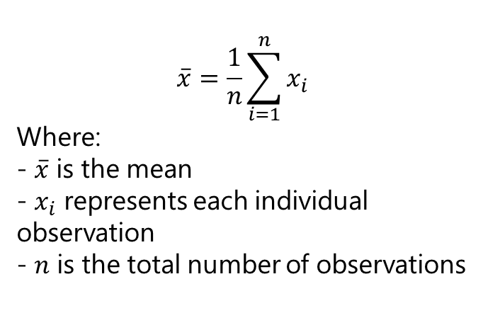
Central distribution Mean
Calculated by summing all values and dividing by the number of observations
Sensitive to every value in the dataset
Affected by extreme values (outliers)
Mostly appropriate for symmetric distributions
$$\overset{‾}{x}=\frac{1}{n}\sum_{i=1}^{n}{x_{i}}$$
Where: - $\overset{‾}{x}$ is the mean - $x_{i}$ represents each individual observation - $n$ is the total number of observations
Notes:
Separation of concern so that different individual can take care of different parts of a project without worrying about other parts of the project.

Slide 23

Central distribution Median
ess_reg %>% mutate( immi_mean = mean(immi, na.rm=T), immi_med = median(immi, na.rm=T) ) %>% ggplot(aes(x=immi)) + geom_density(fill='orange2', alpha=.6) + geom_vline(aes(xintercept = immi_mean), linetype = 'dashed', colour = 'dodgerblue3', linewidth = 1) + geom_vline(aes(xintercept = immi_med), linetype = 'dashed', colour = 'green4', linewidth = 1) + theme_classic()
Notes:
Separation of concern so that different individual can take care of different parts of a project without worrying about other parts of the project.

Slide 24
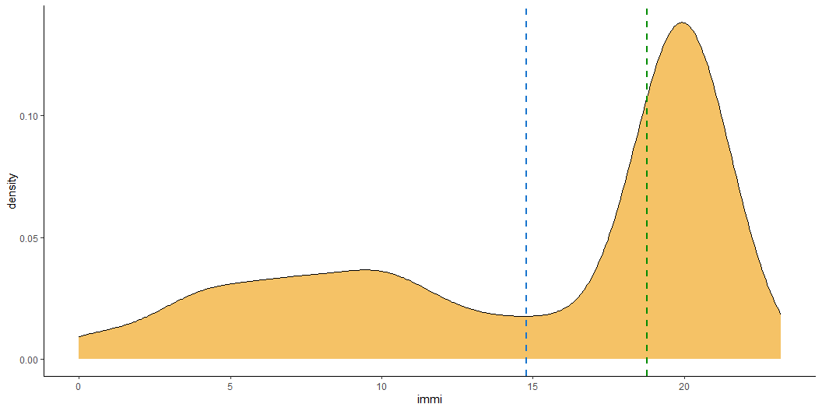
Central distribution Median
set.seed(1234) ess_reg %>% dplyr::select(immi) %>% rbind(.,data.frame(immi = rnorm(1000, mean=20, sd=1))) %>% mutate( immi_mean = mean(immi, na.rm=T), immi_med = median(immi, na.rm=T) ) %>% ggplot(aes(x=immi)) + geom_density(fill='orange2', alpha=.6) + geom_vline(aes(xintercept = immi_mean), linetype = 'dashed', colour = 'dodgerblue3', linewidth = 1) + geom_vline(aes(xintercept = immi_med), linetype = 'dashed', colour = 'green4', linewidth = 1) + theme_classic()
Notes:
Separation of concern so that different individual can take care of different parts of a project without worrying about other parts of the project.

Slide 25
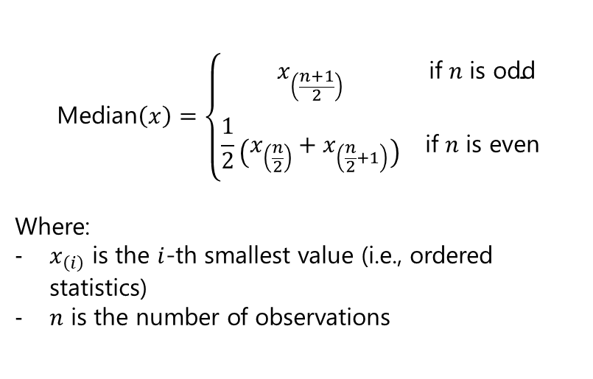
Central distribution Median
The middle value (50% of the distribution) when data are ordered
If even number of observations: average of the two middle values
Not influenced by extreme values or skewed distributions
Best used when the data are ordinal or skewed
$$\text{Median}\left(x\right)=\left\{\begin{matrix}x_{\left(\frac{n+1}{2}\right)} & \text{if} n \text{is} \text{odd} \\ & \\ \frac{1}{2}\left(x_{\left(\frac{n}{2}\right)}+x_{\left(\frac{n}{2}+1\right)}\right) & \text{if} n \text{is} \text{even}\end{matrix}\right.$$
Where:
$x_{\left(i\right)}$ is the $i$-th smallest value (i.e., ordered statistics)
$n$ is the number of observations
Notes:
Separation of concern so that different individual can take care of different parts of a project without worrying about other parts of the project.

Slide 26
Dispersion
Central tendencies are not enough though. Most of the times you want to know how much the data (sample) is dispersed
Dispersion measures describes how spread out data are around the central value
Key measures (for today):
Variance/Standard Deviation
Standard Error of the Mean
Notes:
Separation of concern so that different individual can take care of different parts of a project without worrying about other parts of the project.

Slide 27

Dispersion Variance/Standard Deviation
Variance
Measures the average squared deviation from the mean
Captures how data values spread out from the centre
Units are in squared scale of the original variable
Sensitive to outliers
$$s^{2}=\frac{1}{n−1}\sum_{i=1}^{n}{{\left(x_{i}−\overset{‾}{x}\right)}^{2}}$$
Notes:
Separation of concern so that different individual can take care of different parts of a project without worrying about other parts of the project.

Slide 28
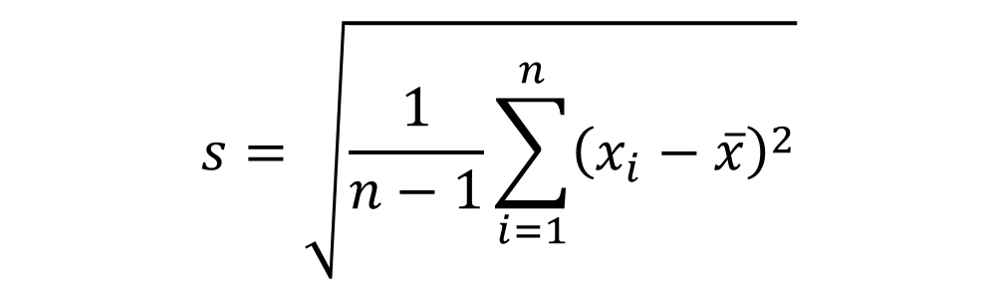
Dispersion Variance/Standard Deviation
Standard deviation
Square root of the variance
Expresses dispersion in original units
Captures how data values spread out from the centre
Units are in original units
Most commonly used measure of spread
Like variance, sensitive to extreme values
$$s^{2}=\frac{1}{n−1}\sum_{i=1}^{n}{{\left(x_{i}−\overset{‾}{x}\right)}^{2}}$$
$$s=\sqrt{\frac{1}{n−1}\sum_{i=1}^{n}{{\left(x_{i}−\overset{‾}{x}\right)}^{2}}}$$
Notes:
Separation of concern so that different individual can take care of different parts of a project without worrying about other parts of the project.

Slide 29

Variance/Standard Deviation
ess_reg %>% mutate( immi_mean = mean(immi, na.rm = TRUE), immi_sd = sd(immi, na.rm = TRUE) ) %>% ggplot(aes(x = immi)) + geom_density(fill = 'orange2', alpha = 0.6) + geom_vline(aes(xintercept = immi_mean), linetype = 'dashed', colour = 'dodgerblue3', linewidth = 1) + geom_vline(aes(xintercept = immi_mean + immi_sd), linetype = 'dashed', colour = 'red', linewidth = 1) + geom_vline(aes(xintercept = immi_mean - immi_sd), linetype = 'dashed', colour = 'red', linewidth = 1) + theme_classic()
Notes:
Separation of concern so that different individual can take care of different parts of a project without worrying about other parts of the project.

Slide 30
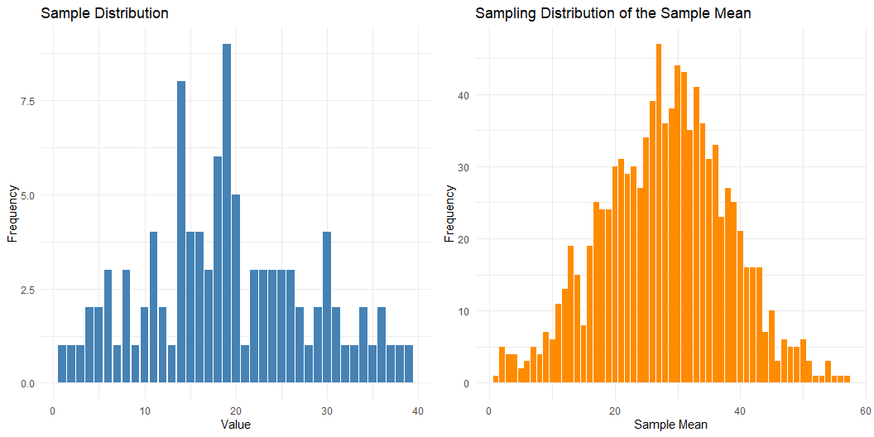
Dispersion Central Limit Theorem
The distribution of the sample mean approaches a normal distribution as the sample size increases, regardless of the population's original distribution – and provided the population has a finite mean and variance
CLICK HERE!
*
Notes:
Separation of concern so that different individual can take care of different parts of a project without worrying about other parts of the project.

Slide 31

Dispersion Standard Error
ess_reg %>% mutate( immi_mean = mean(immi, na.rm = TRUE), immi_se = sd(immi, na.rm = TRUE) / sqrt(sum(!is.na(immi))) ) %>% ggplot(aes(x = immi)) + geom_density(fill = 'orange2', alpha = 0.6) + geom_vline(aes(xintercept = immi_mean), linetype = 'dashed', colour = 'dodgerblue3', linewidth = 1) + geom_vline(aes(xintercept = immi_mean + immi_se), linetype = 'dashed', colour = 'purple', linewidth = 1) + geom_vline(aes(xintercept = immi_mean - immi_se), linetype = 'dashed', colour = 'purple', linewidth = 1) + theme_classic()
Notes:
Separation of concern so that different individual can take care of different parts of a project without worrying about other parts of the project.

Slide 32


Dispersion Standard Error
$$SE_{\overset{‾}{x}}=\frac{s}{\sqrt{n}}$$
Measures the precision of the sample mean as an estimate of the population mean
- Is the standard deviation of the sample mean distribution!
Decreases with larger sample size
Used in confidence intervals and tests for means
Notes:
Separation of concern so that different individual can take care of different parts of a project without worrying about other parts of the project.

Slide 33
Hands-on practice

Slide 34
Basic practice
Download Git:
Go to https://git-scm.com and download the latest version for your operating system (Windows, macOS, or Linux).
Install Git:
Run the downloaded installer.
Use default settings
Verify Installation:
Open a terminal (or Git Bash on Windows) and type:
git version
Notes:
Separation of concern so that different individual can take care of different parts of a project without worrying about other parts of the project.

Slide 35
Basic practice
Create a GitHub account - https://github.com.
Verify Installation
Open a terminal and type:
(Pro: generate an ssh for security reasons)
Notes:
Separation of concern so that different individual can take care of different parts of a project without worrying about other parts of the project.

Slide 36
Basic practice:
Download GitHub Desktop:
Visit the official GitHub Desktop download page and download the installer for your operating system (Windows or macOS).​
Install the Application
Open GitHub Desktop
Sign In to GitHub
Notes:
Separation of concern so that different individual can take care of different parts of a project without worrying about other parts of the project.

Slide 37
Assignment #1
Download GitHub Desktop:
Visit the official GitHub Desktop download page and download the installer for your operating system (Windows or macOS).​
Install the Application
Open GitHub Desktop
Sign In to GitHub
Notes:
Separation of concern so that different individual can take care of different parts of a project without worrying about other parts of the project.

Slide 38
Assignment #1
Create a folder
Create an R project
Create a repository on your machine – using the folder above
Push the folder to Github
Notes:
Separation of concern so that different individual can take care of different parts of a project without worrying about other parts of the project.

Slide 39
Assignment

Slide 40
Assignment #1
Read (a bit)
Resources
See the references!
Agresti & Finlay (2009) - Chapters 1, 2, 3
Notes:
Separation of concern so that different individual can take care of different parts of a project without worrying about other parts of the project.

Slide 41
Assignment #1
Tbd
Probably some coding depending on how it went today
Notes:
Separation of concern so that different individual can take care of different parts of a project without worrying about other parts of the project.

Slide 42
Thank you for your attention!

Slide 43
References
Bueno de Mesquita, E., & Fowler, A. (2021). Thinking clearly with data: A guide to quantitative reasoning and analysis. Princeton University Press.
Agresti, A., & Finlay, B. (2014). Statistical methods for the social sciences (4. ed., Pearson new internat. ed). Pearson.

